Slide 1
FOUNDATION OF DATA SCIENCE CB.EN.U4CSE20218 DUPPALA VIJAYA RAGHAVA
APPLICATION: CRIC BUZZ

Slide 2
ANALYTICAL QUESTIONS:
Pitch is good for batting or bowling?
What is the average runs scored by a respective player?
Winning probability will be more for first batting or second batting?
What is the current net run rate?
What is the current strike rate of a respective player?

Slide 3
Cricbuzz:
it features, news, articles and live coverage of cricket matches including videos, text commentary, player stats and team rankings. Their website also offers a mobile app. Cricbuzz is one of the most popular mobile apps for cricket news and scores in India.

Slide 4
PREDICTIVE QUESTIONS:
Who will be the highest runs scorer in this match?
Who will be winning the next world cup?
How many bowlers are expected to be in the match?
Who will be the wicket keeper for the next match?
When will be the next 50 of MS .Dhoni?
What are the humidity levels of present match?

Slide 5
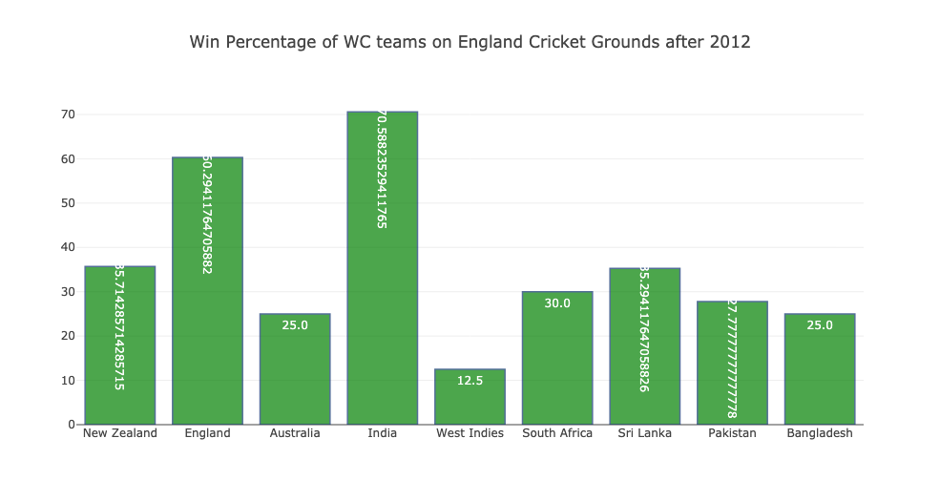
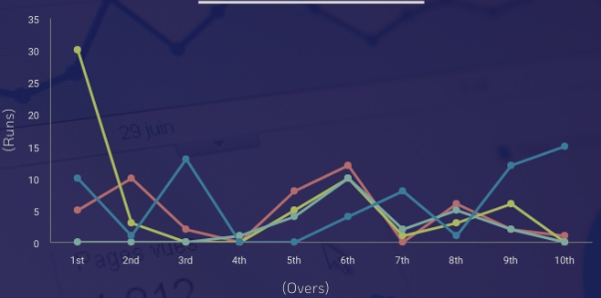
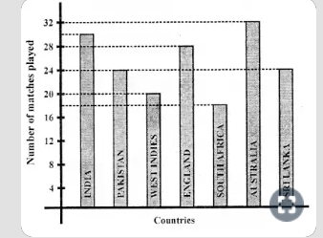
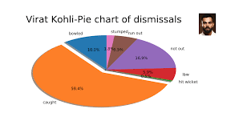
Data Visualization:

Slide 6
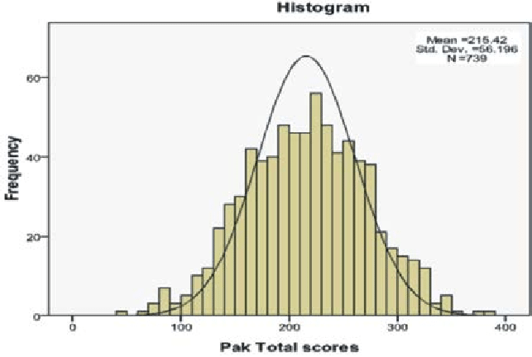
HISTOGRAM:

Slide 7
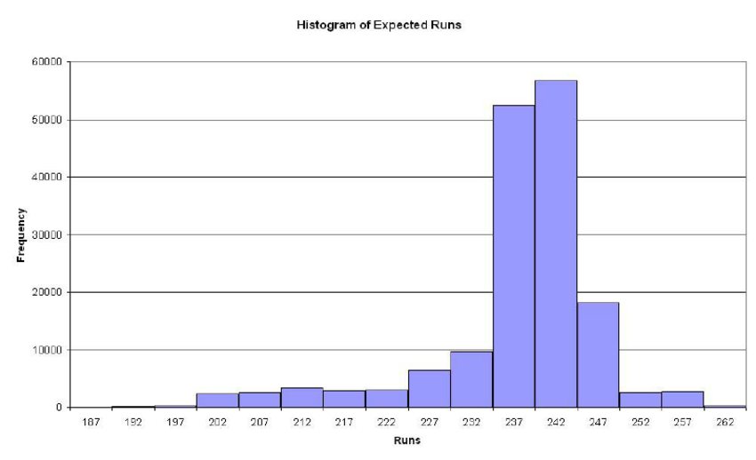

Slide 8
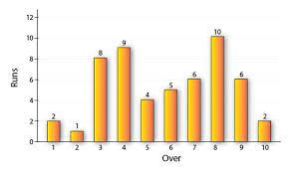
BAR GRAPH

